Slide 1


Joint Meeting Friday 4th May 2012
Contact otology@rsm.ac.uk

Slide 2
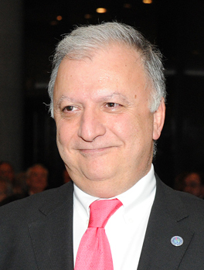
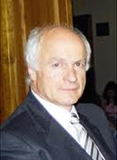
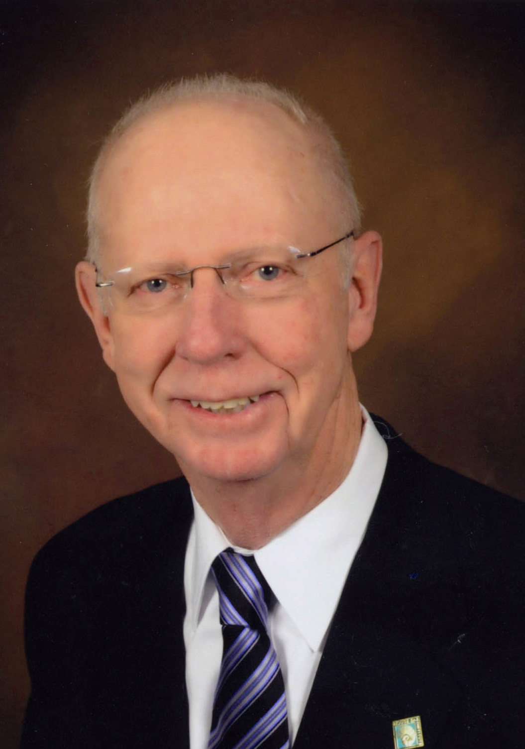
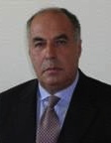

Clinical question and answer session with the Politzer Society
Friday 4th May 2012
Nuri Ozgirgin
Turkey
Jaques Magnan
France
John House
USA
Roberto Fillipo
Italy
Erwin Officiers
Belgium
Politzer panel

Slide 3
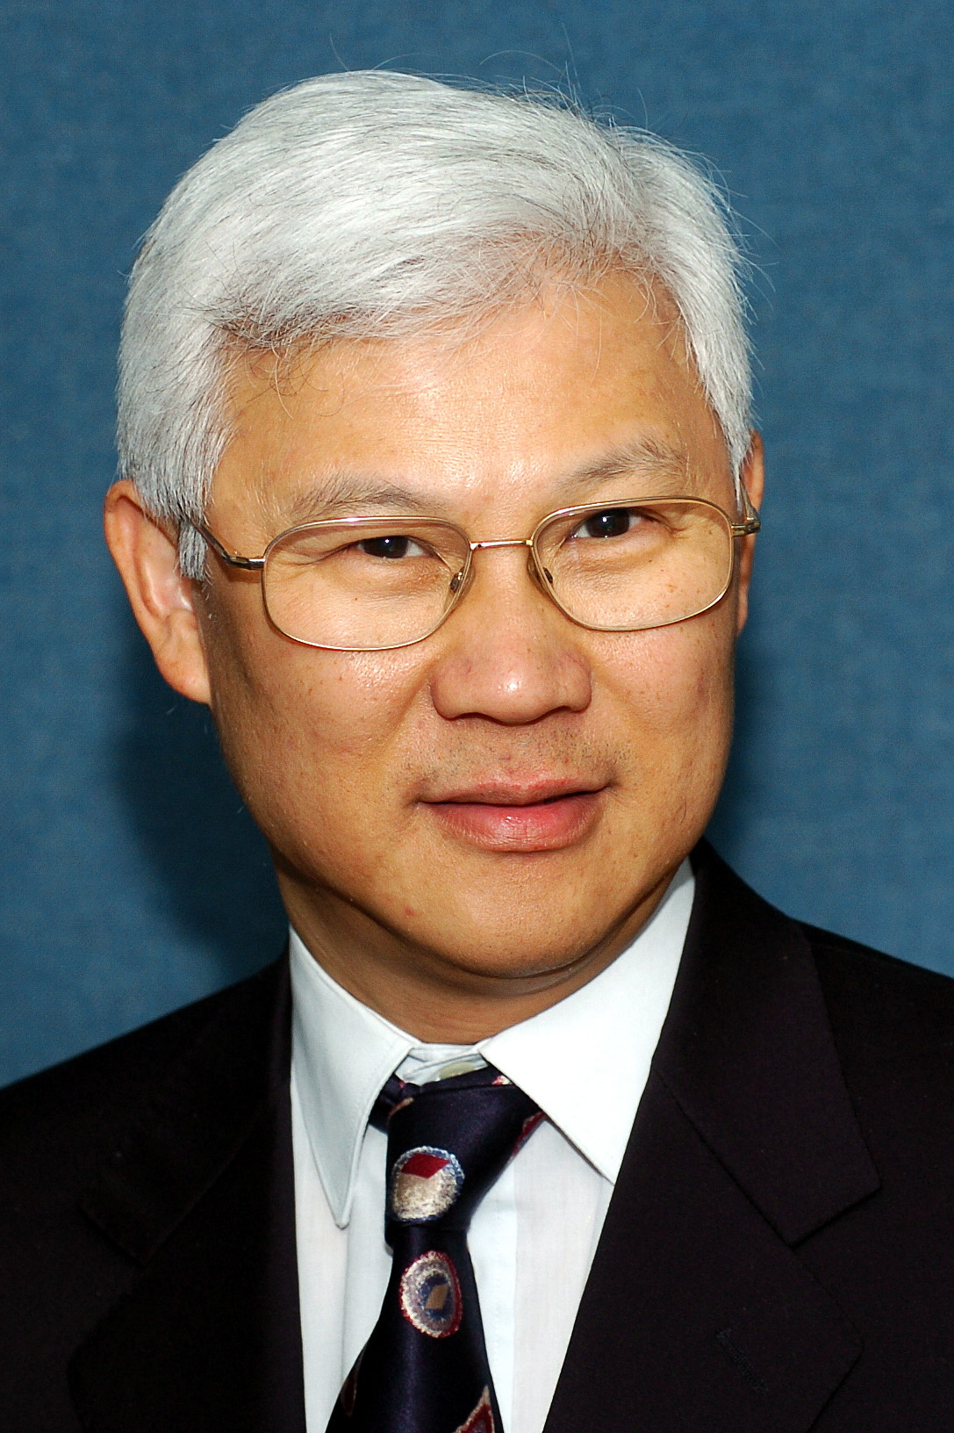
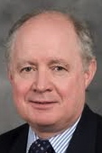
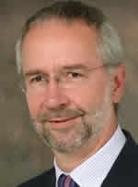
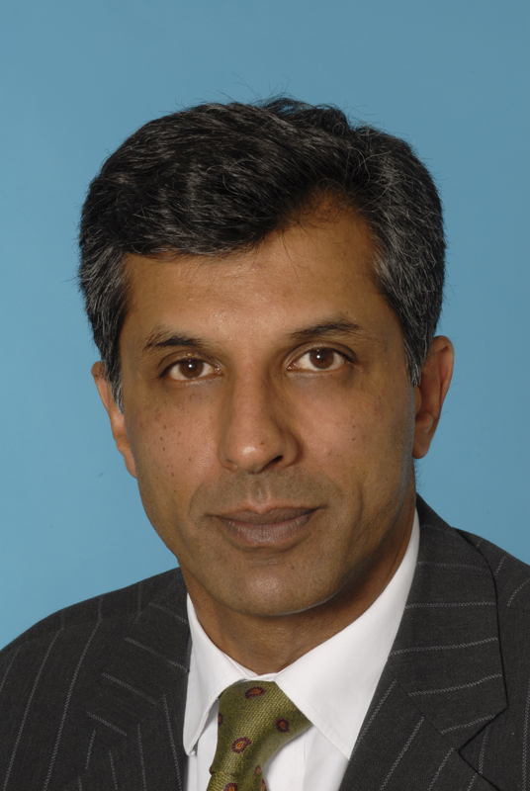
Clinical question and answer session with the Politzer Society
Mathew Yung
Gerry O'Donoghue
Iain Swan
Shak Saeed
UK Panel

Slide 4
Clinical questions
Chronic ear disease
Mathew Yung, Ipswich
Cochlear implants
Gerry O'Donoghue, Nottingham
Vestibular problems
Iain Swan, Glasgow
Skull base
Shak Saeed, London

